Slide 1


Thermal Conductivity Calculation of Argon
by Molecular Dynamics
Yang Zhou
@ Fudan University

Slide 2
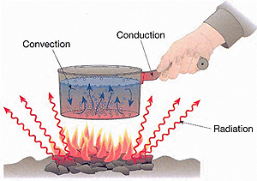
Heat Transfer
Heat transfer ：The phenomenon that heat energy transfer spontaneously from high temperature region to low temperature region when $∆T$ is presented.
Heat conduction：physical contact
Heat transfer
Convection：fluid motion
Radiation：electromagnetic wave.
Notes:
note2015.11.23
1） 把第一和第二页的title Basic Physics…改成短语
2 ) 减少字
3） 修改introduction，向电子器件的散热问题靠拢。

Slide 3
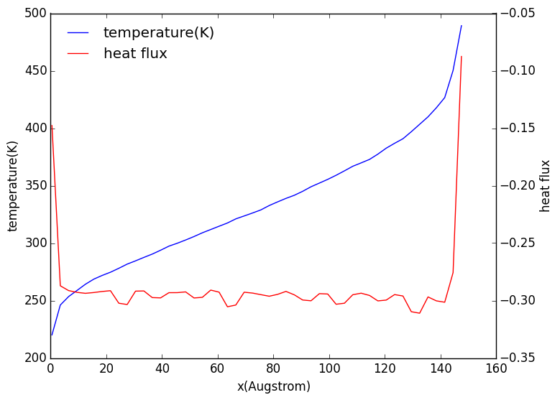
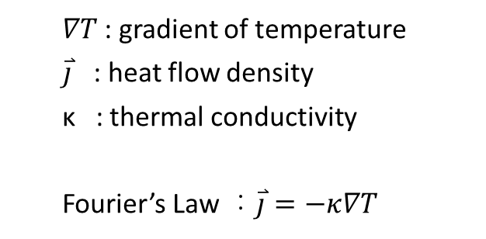
Fourier’s Law
Thermal conductivity : capability of heat conduction
$∇T$: gradient of temperature
$\overset{⃑}{j}$ : heat flow density
κ : thermal conductivity
Fourier’s Law ：$\overset{⃑}{j}=−κ∇T$
T : linear
heat flux : constant

Slide 4
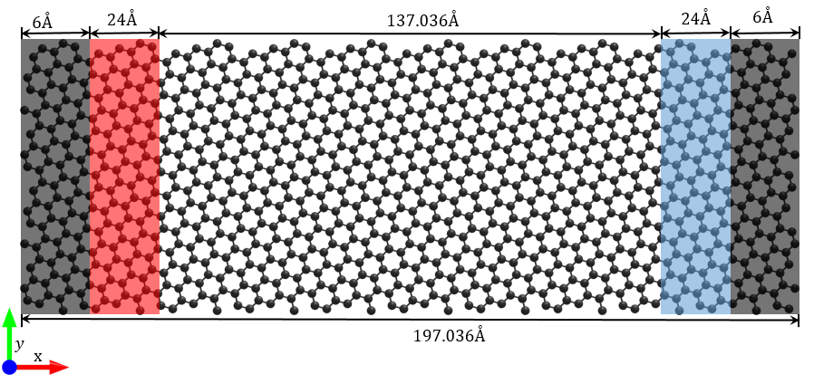
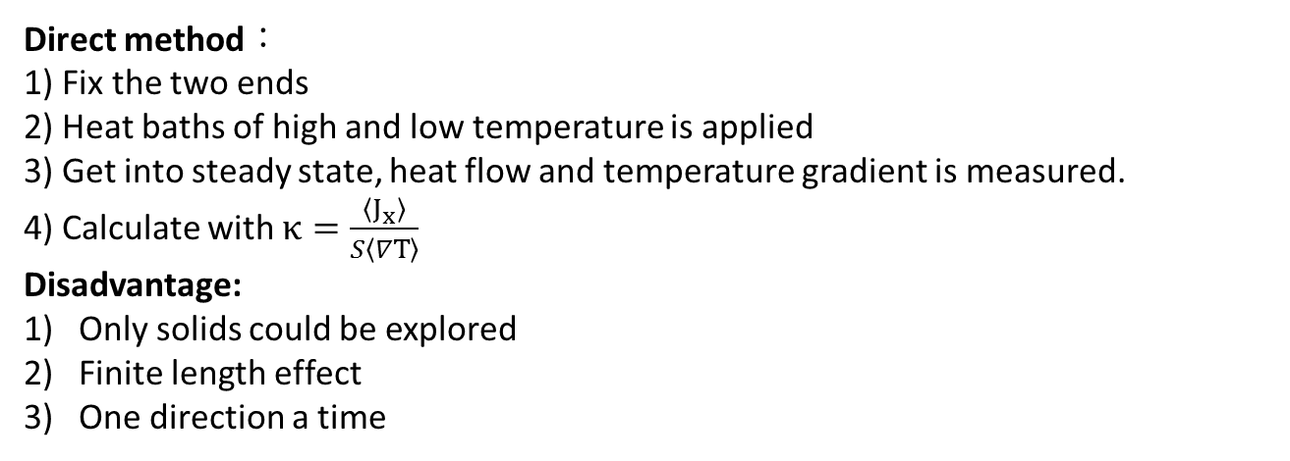
Basic Methods: Molecular Dynamical Simulation
Direct method：
1) Fix the two ends
2) Heat baths of high and low temperature is applied
3) Get into steady state, heat flow and temperature gradient is measured.
4) Calculate with $κ=\frac{〈J_{x}〉}{S〈∇T〉}$
Disadvantage:
Only solids could be explored
Finite length effect
One direction a time

Slide 5
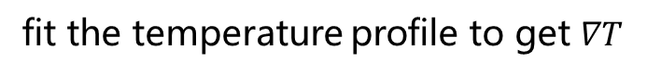

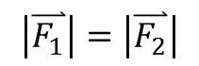
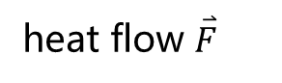
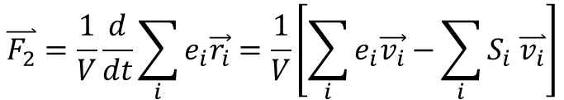
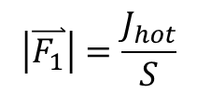

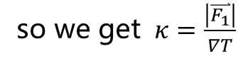
NEMD
$$J_{hot}$$
$$J_{cold}≈−J_{hot}$$
heat flow $\overset{⃑}{F}$
non-periodic
two ways to calculate heat flux
fit the temperature profile to get $∇T$
from source
$$\left|\overset{⃑}{F_{1}}\right|=\frac{J_{hot}}{S}$$
so we get $κ=\frac{\left|\overset{⃑}{F_{1}}\right|}{∇T}$
$$\overset{⃑}{F_{2}}=\frac{1}{V}\frac{d}{dt}\sum_{i}{e_{i}\vec{r_{i}}}=\frac{1}{V}\left[\sum_{i}{e_{i}\vec{v_{i}}−}\sum_{i}{S_{i} \overset{⃑}{v_{i}}}\right]$$
from definition
continuation equation：
$$\left|\overset{⃑}{F_{1}}\right|=\left|\overset{⃑}{F_{2}}\right|$$
particle flow
through potential

Slide 6
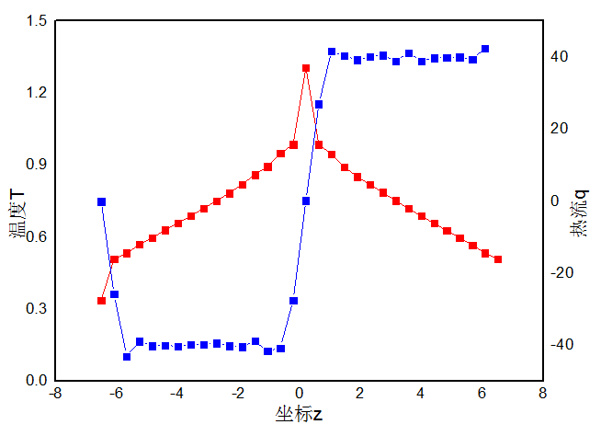
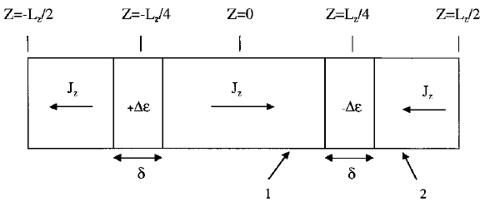
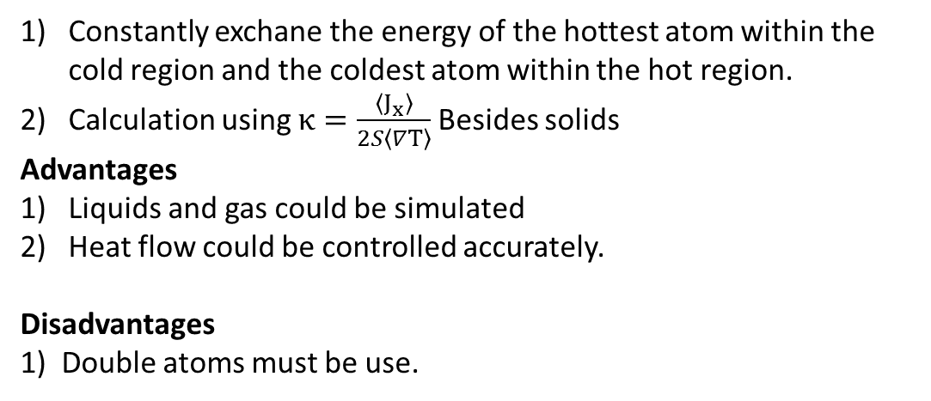
Muller-Plathe Method
Constantly exchane the energy of the hottest atom within the cold region and the coldest atom within the hot region.
Calculation using $κ=\frac{〈J_{x}〉}{2S〈∇T〉}$Besides solids
Advantages
Liquids and gas could be simulated
Heat flow could be controlled accurately.
Disadvantages
1) Double atoms must be use.

Slide 7
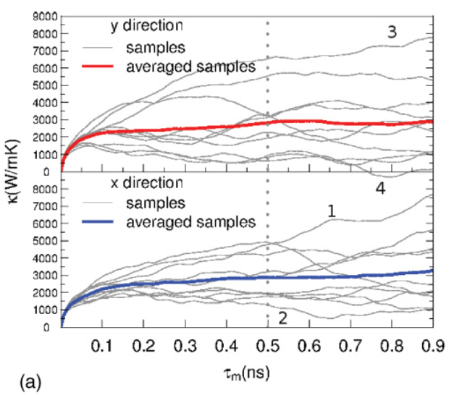
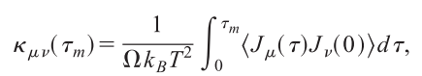
Green-Kubo Method
Calculated by integrate the heat flux autocorrelation function , which is based on a formula from Fluctuation dissipation theorem.
Advantages:
1) The size of the system is not needed to be too large
2) The whole thermal conductivity tensor could be obtained within one simulation
3) The temperature is uniform under equilibrium.
Disadvantages:
The average heat flux autocorrelation function converges really slow =>much computational affordance.
Zhang, H. et.al. Phys. Rev. B 2011, 84 (11), 115460.

Slide 8
Compare
At $T=0.71 ,ρ=0.844$, thermal conductivity of Argon calculated with three methods:
 | direct | Muller-Plathe | Green-Kubo
Condition | 20x10x10 | 20x10x10 | 10x10x10 , 12 seeds
Tc (W/mK) | 0.126 | 0.127 | 0.124

Slide 9
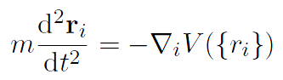
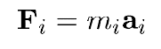
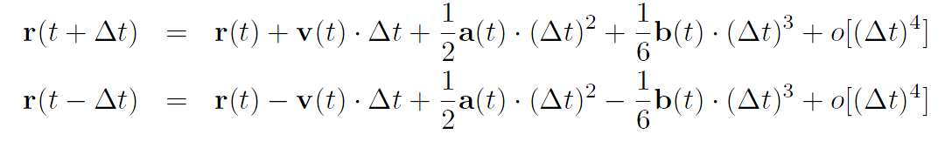
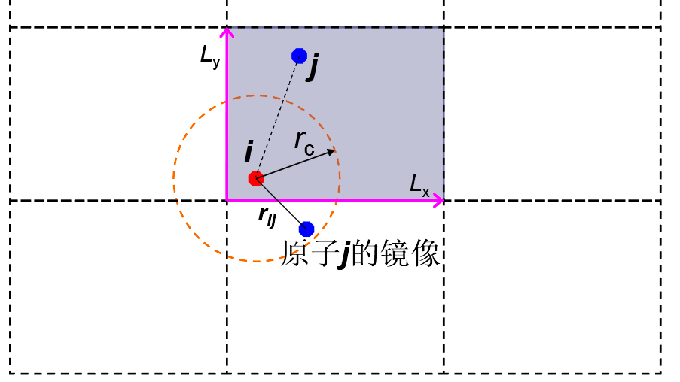

Basic Methods: Molecular Dynamical Simulation
Dynamical Equation
$$⇒$$
Verlet algorithm
Structure & Boundary
Image of j

Slide 10
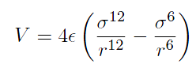
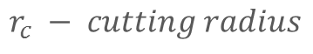
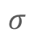
Basic Methods: Molecular Dynamical Simulation
Potential
Lennard-Jones (LJ) Potential
r_{c}
$$σ$$
$$r_{c} − cutting radius$$
Velocity Distribution
Gaussian distribution of Temperature T
Clear out the drift and remaining rotation

Slide 11
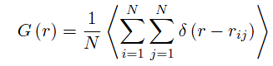
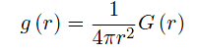
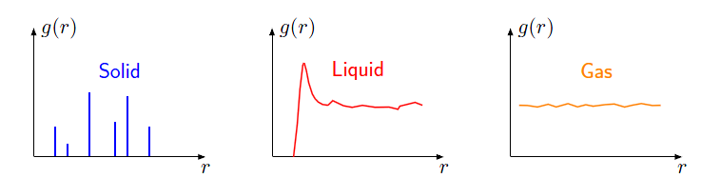
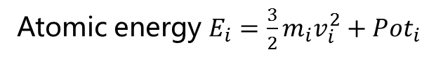
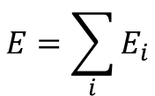
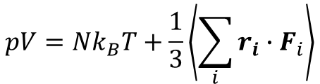
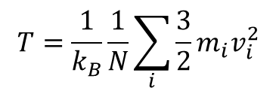
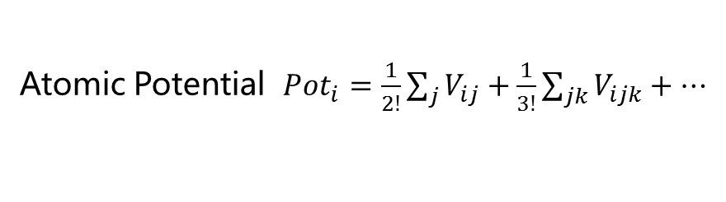
Basic Methods: Molecular Dynamical Simulation
Energy
$$E=\sum_{i}{E_{i}}$$
Atomic energy $E_{i}=\frac{3}{2}m_{i}v_{i}^{2}+Pot_{i}$
Atomic Potential $Pot_{i}=\frac{1}{2!}\sum_{j}{V_{ij}}+\frac{1}{3!}\sum_{jk}{V_{ijk}}+⋯$
Temperature
$$T=\frac{1}{k_{B}}\frac{1}{N}\sum_{i}{\frac{3}{2}m_{i}v_{i}^{2}}$$
$$pV=Nk_{B}T+\frac{1}{3}\left\langle \sum_{i}{r_{i}∙F_{i}}\right\rangle$$
Pressure
Virial Thorem
Radial distribution function(RDF)
Pair-Correlation function

Slide 12
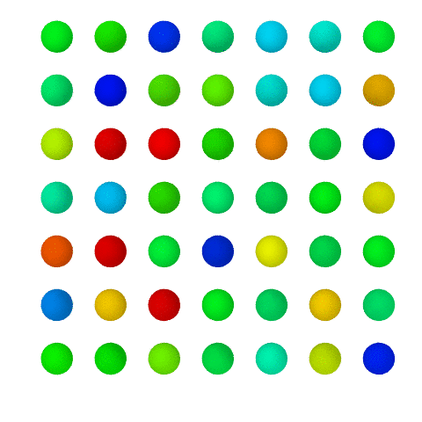
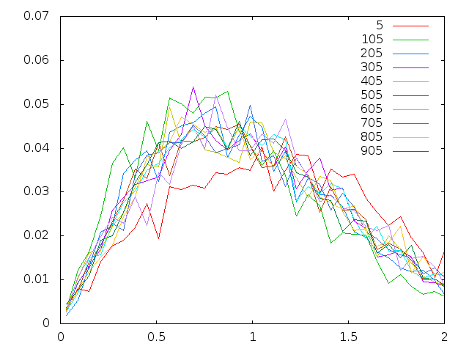
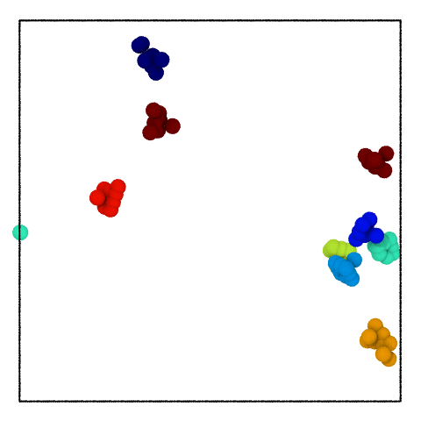
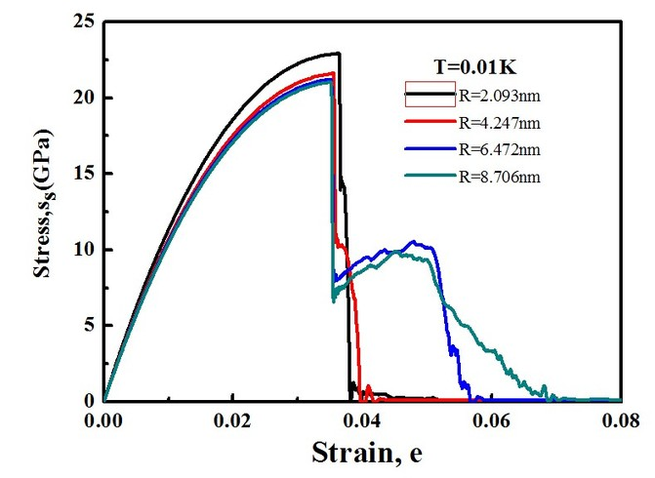
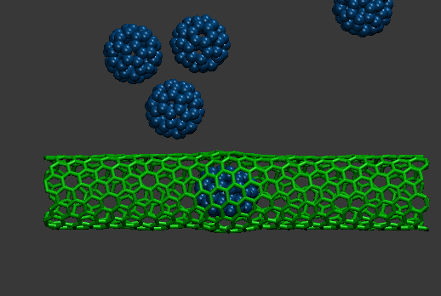
Basic Methods: Molecular Dynamical Simulation

Slide 13

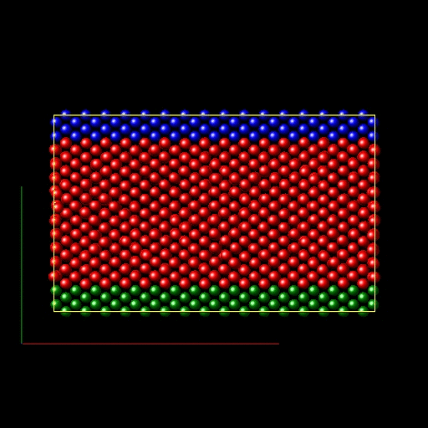
Basic Methods: Molecular Dynamical Simulation

Slide 14
THANK FOR YOUR ATTENTION!
Yang Zhou
@ Fudan University

